Slide 1

Pizza prize prediction analysis
Name :

Slide 2


Introduction
Pizza is a popular food worldwide, with its origins in Italy during the 18th century.
The price of a pizza can vary based on factors like ingredients, cooking method, and brand.
The global pizza market was valued at 178 million USD (Market watch, n.d.).
This project aims to analyze the factors affecting pizza prices and ensure reasonable pricing.

Slide 3
Data source
Variable Name | Description
Company | Manufactured company of the pizza; Categorical
Price_rupiah | Price of a pizza; Continuous
Diameter | Diameter of a pizza in inches; Discrete
Topping | Topping used in the pizza; Categorical
Variant | Type of the variant; Categorical
Size | Which size category for given pizza; Categorical
Extra_souse | Whether the pizza contains extra souse, cheese or mushrooms; Categorical
Extra_cheese
Extra_mushrooms
The dataset used in the study is sourced from Kaggle and focuses on Pizza Price Prediction.
The study examined a dataset with 9 variables and 129 records, focusing on the pizza price in Indonesian rupees.

Slide 4


Method
Data preprocessing involved removing currency symbols and units from relevant columns.
Missing values are checked, and exploratory data analysis is conducted using descriptive statistics and visualizations.
Machine learning models are trained and evaluated using metrics such as Mean Absolute Error, R-squared score, and Root Mean Squared Error.

Slide 5
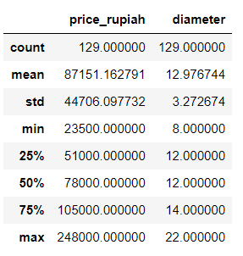
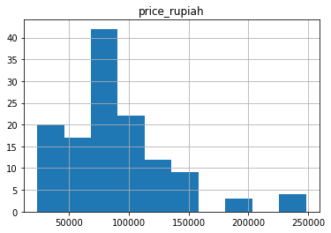
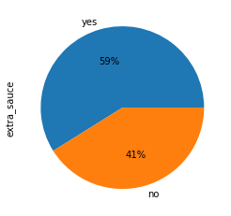
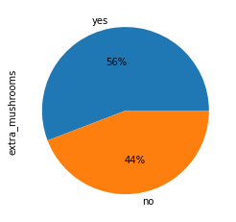
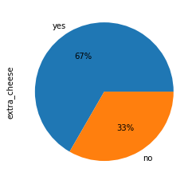
Exploratory data analysis
Pizza with Extra mushrooms, Extra Sauce, or Extra mushrooms shows a higher count than those without extra cheese, extra sauce, or Extra mushrooms.
skewness of data towards the lower prize values.
The mean of the pizza prices is 87151. The median of the dataset is 78000 which indicates most people interested in purchasing a pizza are around 7800 rupees

Slide 6
Model selection
1. Linear Regression:
Purpose: Linear Regression is a simple, yet powerful model used for predicting continuous values, such as pizza prices. It assumes a linear relationship between the independent variables (features) and the dependent variable (price).
Training Process: The model is trained by fitting a line to the training data that minimizes the difference between the actual prices and the predicted prices
2. XGBoost Regression:
Purpose: XGBoost Regression is an advanced ensemble model that excels in capturing complex relationships in the data and provides high predictive performance. XGBoost Regression is well-suited for predicting pizza prices as it can handle non-linear relationships and capture interactions between features effectively.
Training Process: The model is trained using a gradient boosting framework. During training, XGBoost adjusts the weights based on the errors made by the previous models, giving more emphasis to the instances with higher errors.
These models provide valuable insights into the factors affecting pizza prices and can be utilized to make accurate price predictions for pizzas.

Slide 7
Results
Evolution Metric | Linear Regression | Linear Regression with Hyperparameter tuning | XGBoost Regressor
Mean Absolute Error | 17253.9094 | 10494.7310 | 6103.5108
R2 score | 0.4812 | 0.7972 | 0.8999
Root Mean Squared Error | 21173.2847 | 13238.1920 | 9296.7691
Hyperparameter tuning is performed using GridSearchCV to find the best model and hyperparameters.
The analysis shows that the XGBoost Regressor performs better than both models in terms of all performance metrics. The XGBoost model exhibits higher accuracy, greater explanatory power, and smaller prediction errors, making it the most suitable model for predicting pizza prices based on the dataset.

Slide 8


Future works
Advanced Modeling Techniques: Consider advanced algorithms like ensemble methods or deep learning.
Fine-tune Hyperparameters: Optimize model parameters for improved performance.
Improve Data Quality: Address data quality issues for a more reliable dataset.
Expand the Scope: Include additional factors like customer reviews or promotions for a comprehensive analysis.
Industry Collaboration: Collaborate with pizza companies for more data and expert insights.

Slide 9
reeferences
Kaggle. (n.d.). Retrieved from Pizza Price Prediction: https://www.kaggle.com/code/knightbearr/regression-pizza-price-prediction-knightbearr/input?scriptVersionId=84068520
Market watch. (n.d.). Retrieved from Global "Pizza Market" Significant Growth Forecast by 2028 |New Entrants, Challenges, Leading Competitors: https://www.marketwatch.com/press-release/global-pizza-market-significant-growth-forecast-by-2028-new-entrants-challenges-leading-competitors-2023-03-02#:~:text=Trends%20%7C%20Competitive%20Analysis-,The%20global%20Pizza%20market%20size%20was%20valued%20a
Scikit - learn. (n.d.). Retrieved from https://scikit-learn.org/stable/supervised_learning.html#supervised-learning

Slide 10
Thank you..!

